Slide 1
AMAZON SALES ANALYSIS
Akshay S - 1RN20IS010
Anish Para - 1RN20IS017

Slide 2
Contents
Data preprocessing (cleaning)
Different plots
Exploratory Data Analysis
One-hot encoding
Model building – regression
Sentimental analysis

Slide 3
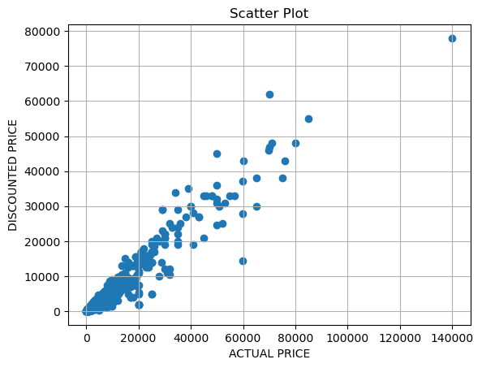
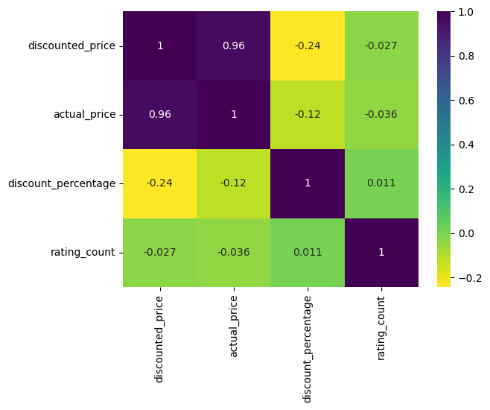
Plots-

Slide 4
Exploratory Data Analysis
# Extract the top 10 main categories by count and create a DataFrame with counts
main_cat_pro = df1['Main category'].value_counts().head(10).rename_axis('Main category').reset_index(name='count')
# Extract the top 10 sub-categories by count and create a DataFrame with counts
sub_cat_pro = df1['Sub category'].value_counts().head(10).rename_axis('Sub category').reset_index(name='count')
# Create a figure with two subplots (2 rows, 1 column), specifying the size
fig, ax = plt.subplots(2, 1, figsize=(8, 10))
# Create a bar plot for the main categories in the first subplot (ax[0])
sns.barplot(ax=ax[0], data=main_cat_pro, x='count', y='Main category')
# Create a bar plot for the sub-categories in the second subplot (ax[1])
sns.barplot(ax=ax[1], data=sub_cat_pro, x='count', y='Sub category')

Slide 5
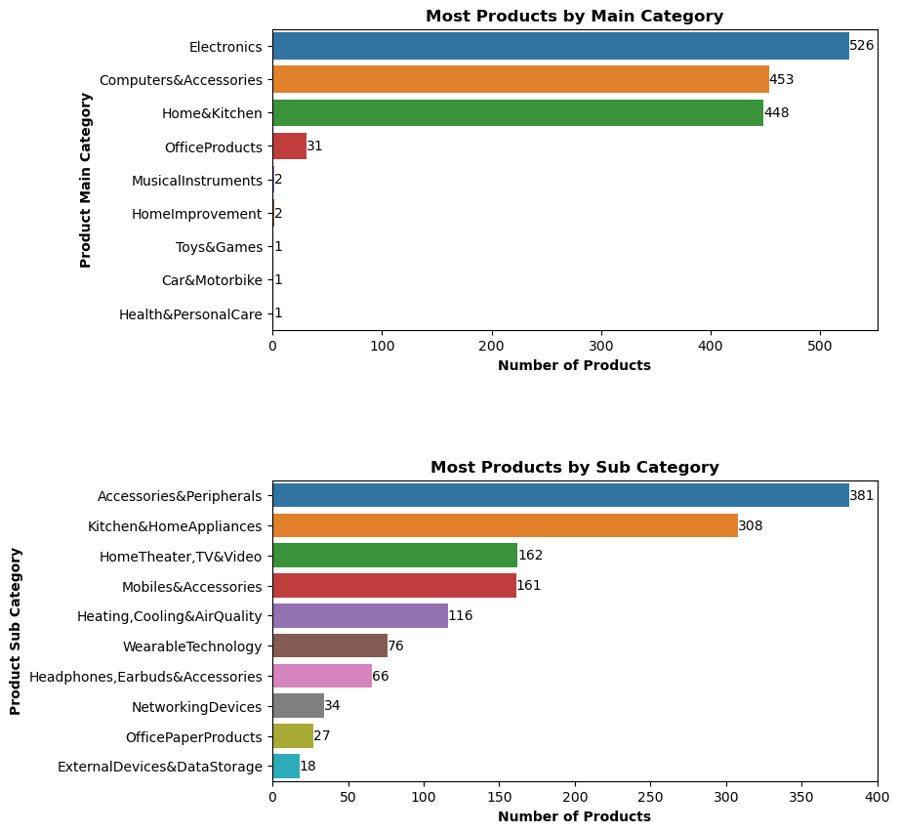

Slide 6
Model building
STEPS IN MODEL BUILDING
specify the dependant(y) and independant variable (x)
split your data in training and testing
model building: model.fit(train) model.predict(test)
check the model performance

Slide 7
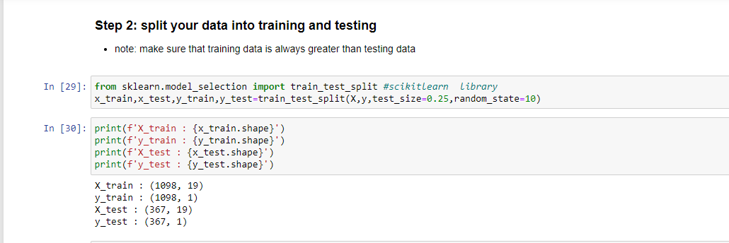

Slide 8
X = df1_encoded[['actual_price','discount_percentage','rating_count','Main category_Car&Motorbike','Main category_Computers&Accessories','Main category_Electronics','Main category_Health&PersonalCare','Main category_Home&Kitchen','Main category_HomeImprovement','Sub category_Microphones','Sub category_Mobiles&Accessories','Sub category_Monitors','Sub category_NetworkingDevices','Sub category_OfficeElectronics','Sub category_OfficePaperProducts','Sub category_PowerAccessories','Sub category_Printers,Inks&Accessories','Sub category_Tablets','Sub category_WearableTechnology']]
y = df1_encoded[['discounted_price']]
mean-sqaured-error : should be minimum for the best fit line
root-mean-squared-error:to scale down mse
R2 score indicates that a percentage of the variance in the dependent variable is explained by the model. This suggests that the model provides a better fit to the data
Conclusion:
R2 values typically range from 0 to 1.
r2=0.94 means that 94% of the variance in the dependent variable is explained by the independent variables in the model.

Slide 9
Sentimental Analysis
VADER (Valence Aware Dictionary and sentiment Reasoner) is a rule-based sentiment analyzer that has been trained on social media text

Slide 10
Steps in sentimental analysis
Representing column named ‘review_title’ in the form of a list
Importing re to clean the reviews (removing emojis)
Removing stopwords to get filtered_reviews from cleaned_reviews
'review': review,
'sentiment': sentiment,
'positive_score': sentiment_scores['pos'],
'negative_score': sentiment_scores['neg'],
'neutral_score': sentiment_scores['neu'],
'compound_score':

Slide 11
'review': The original text of the review.
'sentiment': The sentiment label based on the compound score. It can be 'positive', 'negative', or 'neutral'.
'positive_score': The proportion of the text that is estimated to be positive.
'negative_score': The proportion of the text that is estimated to be negative.
'neutral_score': The proportion of the text that is estimated to be neutral.
'compound_score': A metric that represents the overall sentiment of the text. It combines positive, negative, and neutral scores into a single score. The range of compound scores is -1 (most negative) to +1 (most positive)

Slide 12
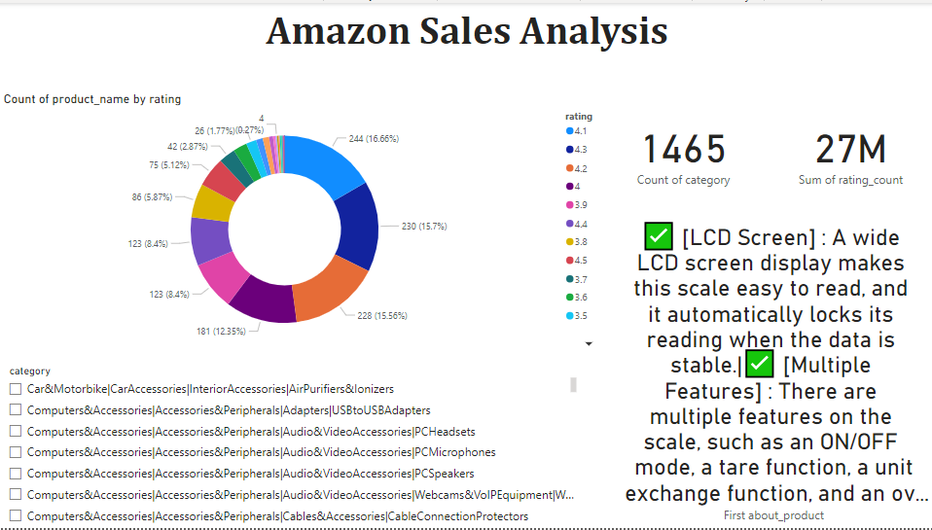
Power Bi dashboard
Dashboard for raw data

Slide 13
Thank You!
Akshay S - 1RN20IS010
Anish Para - 1RN20IS017

